Slide 1

Are worse winters predictive of alcoholism?
To better manage staffing, a treatment provider asks a data scientist:
Ross Brown Data Science and Psychometrics

Slide 2
Managing Staffing Levels is Critical for Twin Towns Substance Abuse Treatment Network
Labor biggest expense.
Need to balance sufficient staffing for quality care and preventing employee burnout with costs of overstaffing
Need to predict patient demand in new markets for corporate expansion

Slide 3
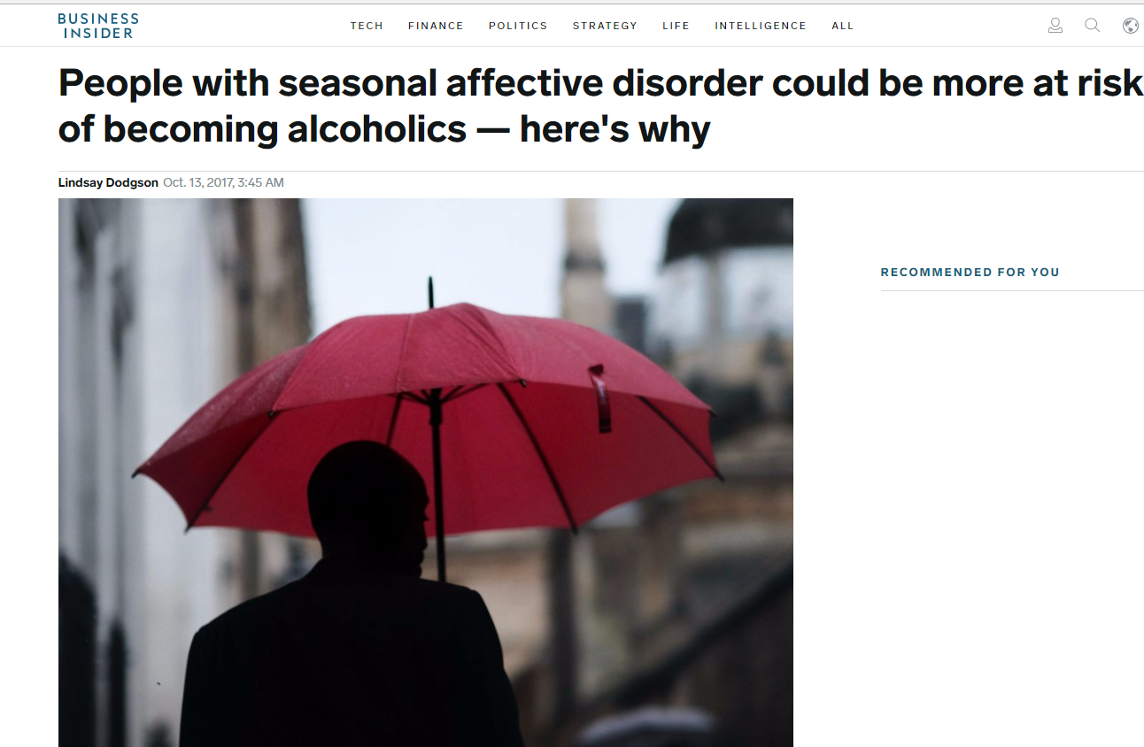
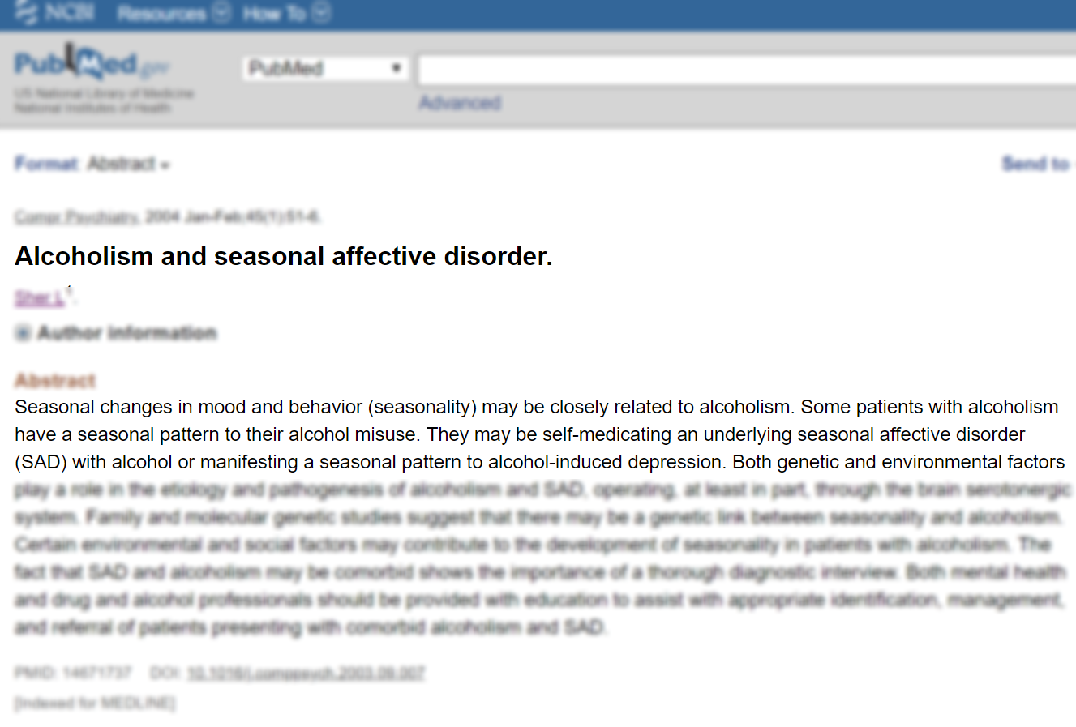
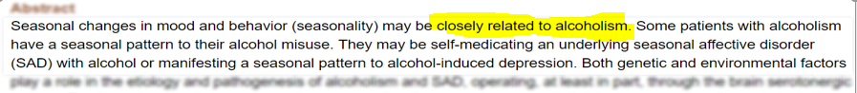
Seasonal Affective Disorder (SAD)
Why winter weather may predict alcoholism:
Depression-like mood disorder associated with
winter weather features:
Shorter days
Reduced sunshine
Isolation
Research has shown that SAD is related to and possibly predictive of alcoholism
Notes:
The hypothesis that winter weather may predict alcoholism is based on seasonal affective disorder, or SAD.
SAD is a depression like mood disorder associated with features of the winter season such as
shorter days
reduced daylight.
Isolation
Alcoholism often associated with SAD

Slide 4
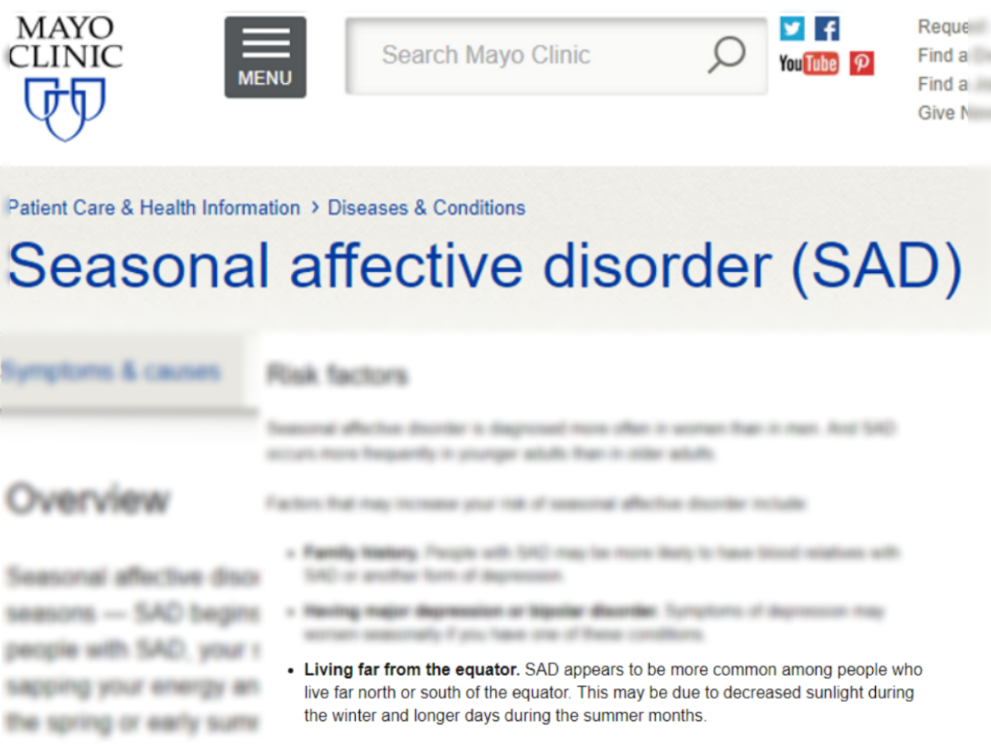
Winter = SAD = Alcoholism
Winter is Harsher, More Severe
Seasonal Affective Disorder is more Widespread and/or more Severe
More Alcoholism

Slide 5
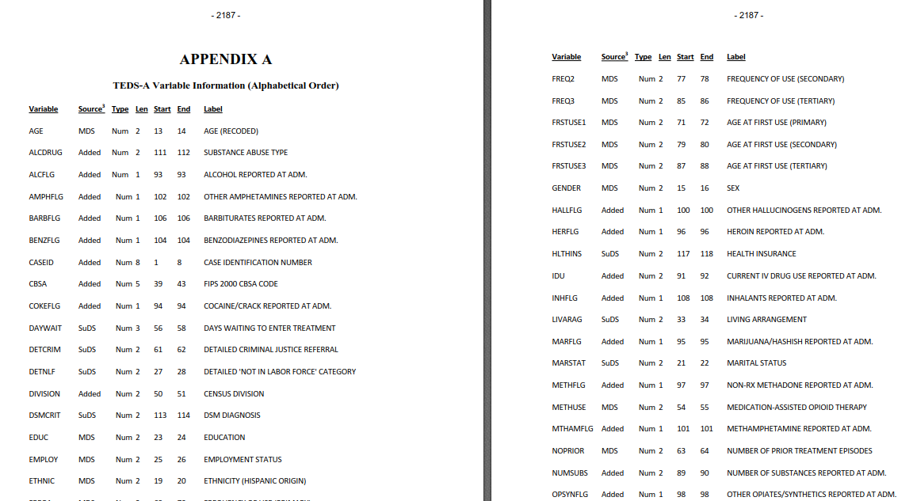
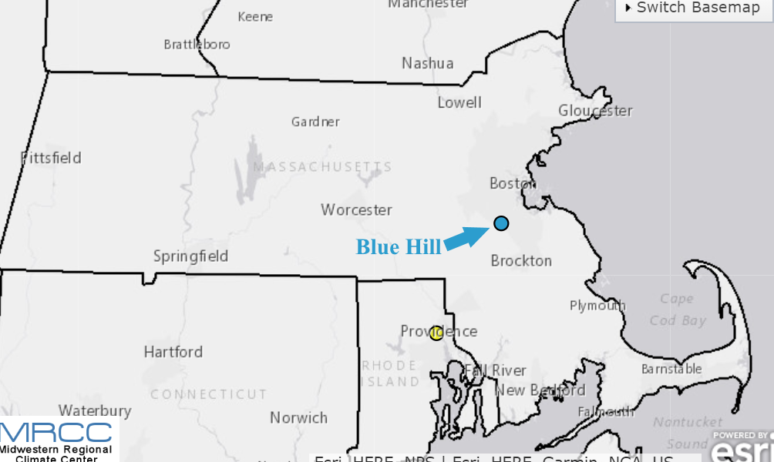
The Study Plan and the Data
Pilot study: manage costs but create meaningful, generalizable findings
Alcoholism admissions: Massachusetts data from a comprehensive census of annual admissions to substance abuse treatment facilities from 1992 – 2014.
Weather: A winter severity index as reported in Blue Hill, Massachusetts

Slide 6
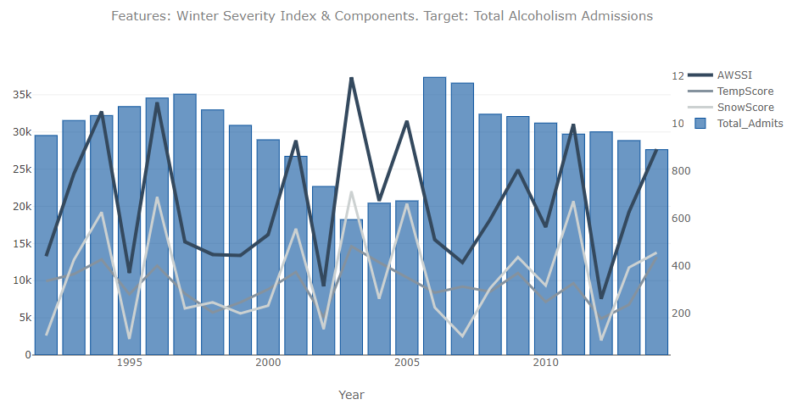
Findings: Winter Severity Index and Alcoholism
Winter severity index (AWSSI) is comprised of overall severity, snow component, temperature component.
What does it look like when plotted against alcohol admissions?
The height of bars are the number of alcoholism admissions, the lines are the winter severity and components.
A pattern emerges,
One that is repeated,
And is also reversed

Slide 7
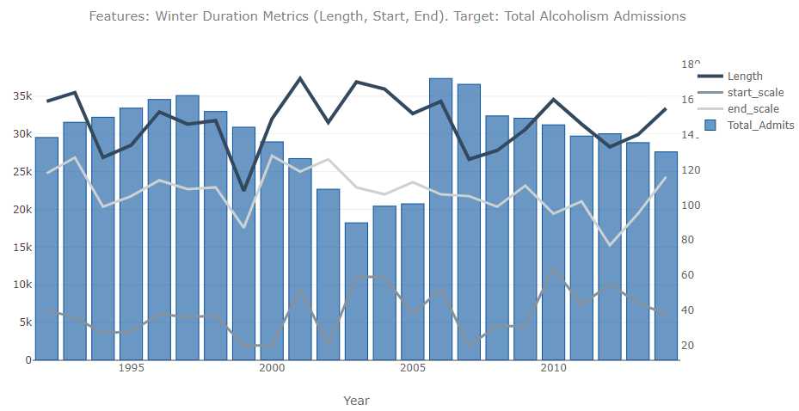
Moderate, negative relationship between winter severity and alcoholism
For winter duration metrics – start date, end date and length – the effect was much less pronounced

Slide 8
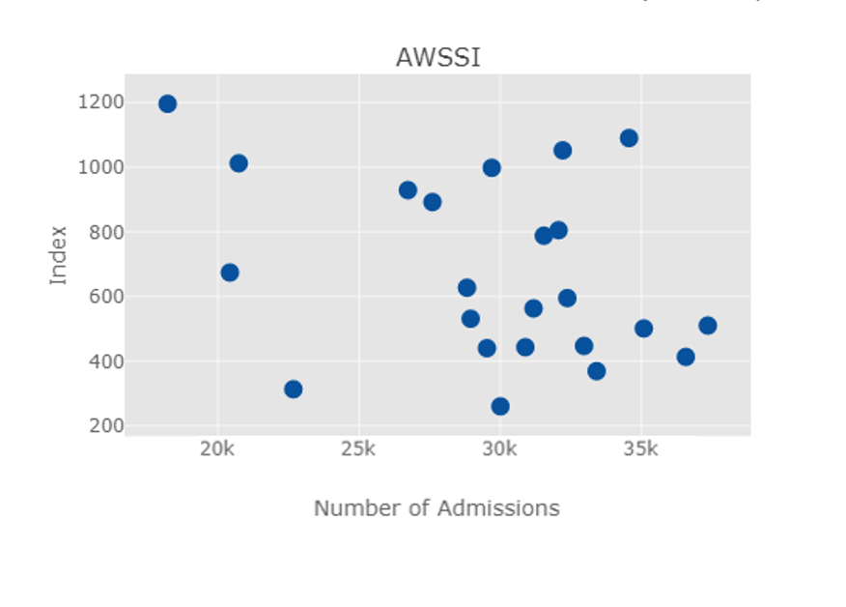

Other data visualizations showed same relationships
Scatterplot, where each dot represents one year:
As winter severity INCREASES on the vertical axis,
the number of admissions, on the horizontal axis, DECREASES.

Slide 9
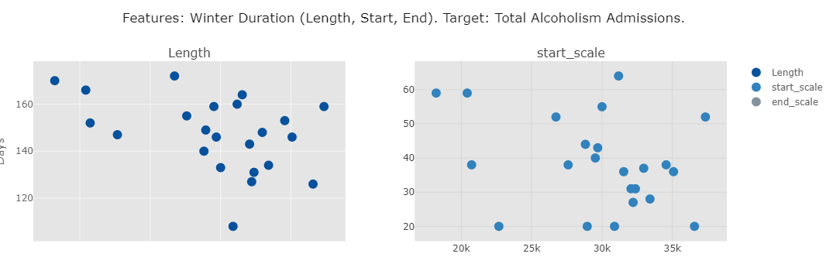

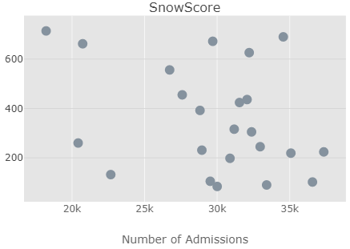
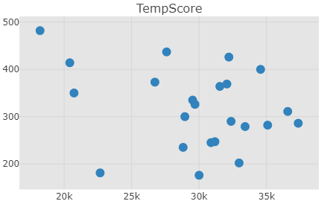
Across winter severity metrics: Same moderate negative relationship

Slide 10
Initial data visualization: Revise hypothesis
Relationship appears to be reversed.
Milder winter weather coincides with more alcoholism admissions.
We can make predictions from negative relationships
Let’s look as some numbers describing these negative relationships

Slide 11
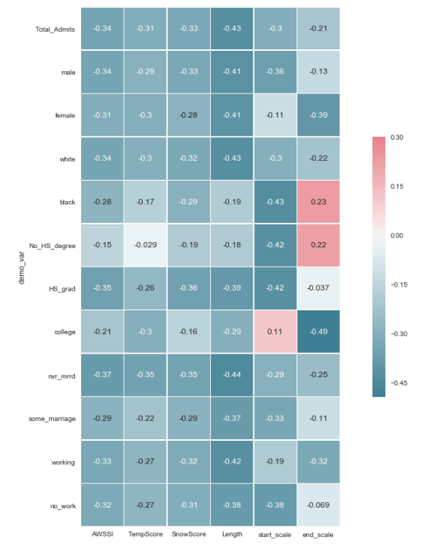
Quantifying degree to which alcohol admits increase as winter severity decreases:
Correlations:
Negative correlation (i.e., -0.3) means one goes up while the other goes down.
We have mostly negative relationships between alcohol admissions and its subgroups and the winter weather severity measures.
Darker the cell color, the greater the relationships.

Slide 12
Quantifying degree to which alcohol admits increase as winter severity decreases:
Correlations:
Quantifying degree to which alcohol admits increase as winter severity decreases:
NOT A LOT
Correlation of -1.0 indicates a perfect, +to -1, relationship.
Length and start scale have the strongest negative correlations, for total admissions and subgroups.
Relationships shown here are weak.

Slide 13
Making predictions: Problematic data
The likelihood a predictive algorithm could be developed was reduced because of:
Characteristics of the data:, i.e., only 23 data points.
Characteristics of the outcome we were attempting to predict, i.e., a large numerical range.
Taken together:
Hampered our ability to reliably replicate and verify any observed effects.
All applicable techniques failed to produce a usable predictive result.
The consistent, observable relationship between winter severity and alcoholism intake
didn’t have enough predictive power when applied to a population.
Conducting all regression analyses models did lead to findings that could be implemented
Nonetheless, this study provides
TT with meaningful, actionable information

Slide 14
Project implications
Found evidence of a relationship between winter severity and alcoholism
Opposite of expectation; a reconceptualization of the dynamics may emerge.
Perhaps more severe winters spur people to alleviate isolation by seeking out socialization. The effect of active engagement with others may be a counterweight to any increase in seasonal affective disorder brought on by a harsh winter.
If future studies find consistent and/or greater evidence of the effect found with this data, winter weather may join unemployment and marital status as an external factor understood to be an important element of alcoholism epidemiology.
The following slides describe specific ways
TT can apply the study findings

Slide 15
Twin Towns has clear direction to
answer its initial business questions:
Can we save money, improve staff morale and
patient outcomes, and target markets for
expansion using winter severity data?
If so, how?
Step 1:
A critical and affordable early step would tell Twin Towns whether the weak-to-
moderate winter severity/alcoholism relationship will have any bearing on its costs, staff morale, and patient treatment outcomes. Overlaying the publicly available winter severity data with its own patient admissions, staffing
needs would tell Twin Towns whether the benefits in these areas are limited to the margins, or are worth making changes to achieve these operational benefits.

Slide 16
Putting findings into action:
minimal staff time and zero incremental
Low-cost and effective steps requiring
equipment costs
Step 2:
Collect and track the daily, cumulative winter severity data that is publicly available, and enter it in an Excel spreadsheet formula that will automatically generate line charts showing ongoing changes in winter severity on a daily basis. Tweak staffing levels based on these trends and monitor outcomes in terms of the match between
staff levels and patient demands, noting staff surpluses and shortages as they occur. Review and revise as needed.
Winter start date had was one of the most predictive winter severity metrics, and it is available prospectively. The date is announced when it occurs. Twin Towns need only consider the date relative to historic mean, median, and outliers,
as well as rolling averages, and use this information to make staffing decisions. Review and revise as needed.

Slide 17
Twin Towns has ready access to qualitative data to supplement and leverage quantitative findings from this study: Staff and patients can shed light on the weather/alcoholism dynamic
Step 3:
Use brainstorming and anecdotal data from staff observations to develop simple questions or survey
response items – directly relating to winter weather effects – that can be easily incorporated into intake and treatment
protocols. Simple, affordable analysis of the data, with close attention to periods of mild winter weather and heavy
patient intake, can point to actionable patterns. Survey patients about the dynamics of alcoholism onset, tying survey questions to
winter weather patterns.

Slide 18
Questions?

